Slide 1




Chapter 13:
Filecoin Virtual Machine
Beginners Guide to Filecoin
Content created by Brown Zhang
Researcher @ KEN Labs

Slide 2
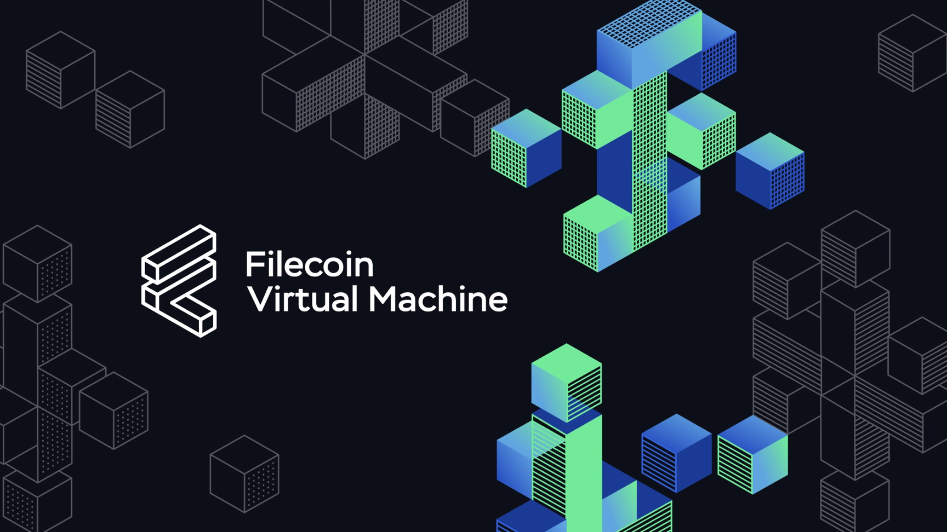
Introduction
The Filecoin network is blazing a trail as the go-to platform for storing and accessing NFTs, public good datasets, Web3, and Metaverse assets. It's not just a mere I/O layer of Web3 – Filecoin now has the potential to offer even more value by adding general smart contract programmability.
Officially launched on mainnet on March 14, the Filecoin Virtual Machine is set to become the core component of the next stage of the decentralized storage ecosystem's evolution.

Slide 3
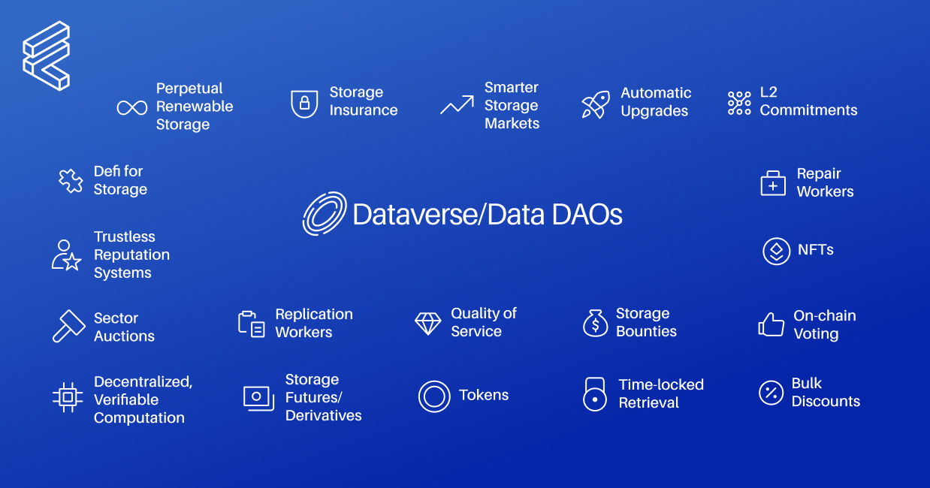
The value of smart contracts
FVM & smart contracts: on-chain programmability
It enables developers to customize what the Filecoin network can do for its users besides storage and retrieval.Helping first-time developers to build — not with Filecoin, but rather on Filecoin as a platform.
Some applications: Data DAOs, liquid staking, storage-collateralized lending, decentralized compute and a lot more are possible with FVM.

Slide 4
How FVM leads to responsible data preservation
First: staking and loans.
providers access FIL, reputation scores, automatically repaid.
FVM unlocks new programmable storage tools that can offer multi-protocol storage retrieval, assurance contracts, data bounties, and many more.
1
3
With FVM, perpetual storage becomes a simple smart contract on top of Filecoin's verifiable storage proofs.
FVM is also unlocking a new way for the Filecoin ecosystem to monetize and coordinate.
2
4

Slide 5
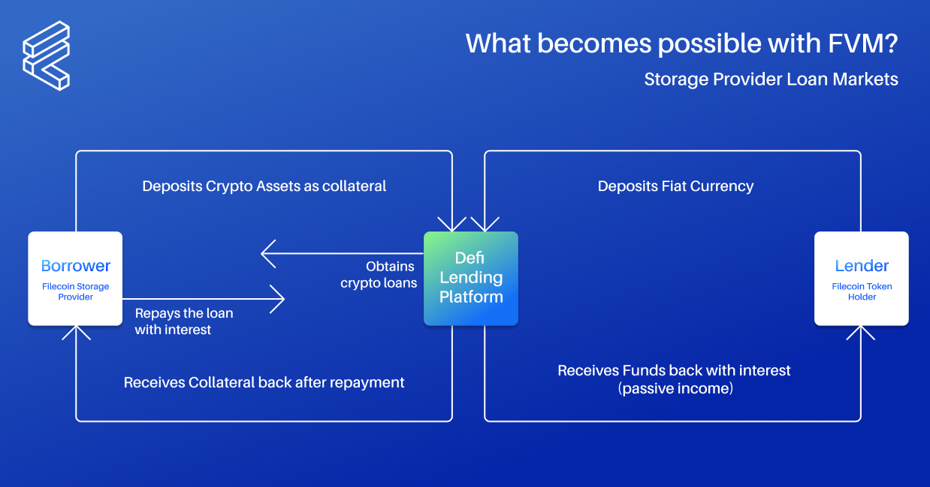
New tools governing data access
Governing data access:
Data access controls
a group of individuals or organizations to curate and preserve a collection of data
program your own smart contract.
To unlock compute over data stored in Filecoin to enable web-scale applications.

Slide 6
A new approach to architecture, developer experience and community growth
Architecture: We envisioned a system that could host multiple runtimes and serve as a seamless conductor between them.
Developer experience:
What we're trying to build – whether FVM is a multi-runtime environment such that these runtimes are developing – we'll be able to host them on the FVM and give them seamless access to storage.
On the other hand, we also drew inspiration from the Linux kernel itself, like isolation, how we manage and map memory, the environment storage abstractions and the way that workloads, programs and smart contracts are able to access those through syscalls.

Slide 7
A deeper dive into the technical architecture of FVM
FVM is based on WebAssembly.Using Wasmtime from the Bytecode Alliance in reference implementation of the FVM.
FVM is actually content addressed data.
FVM is that it supports foreign addressing.
The FVM also performs gas accounting and execution halt by instrument.
This is currently just built-in actors, because the FVM, as it stands in mainnet, is not programmable yet.

Slide 8

The next step: Meet Wallaby
Wallaby is our bleeding edge testnet.
Functions:
delivering data to Wallaby every week
having a hosted RPC endpoint faucet and a wallet
supporting the Ethereum JSON-RPC API

Slide 9

A closer look at various tools and the development experience
The current development experience looks like with some of these tools.
Metamask
Remix
Hardhat
Solidity(Filecoin.sol)

Slide 10
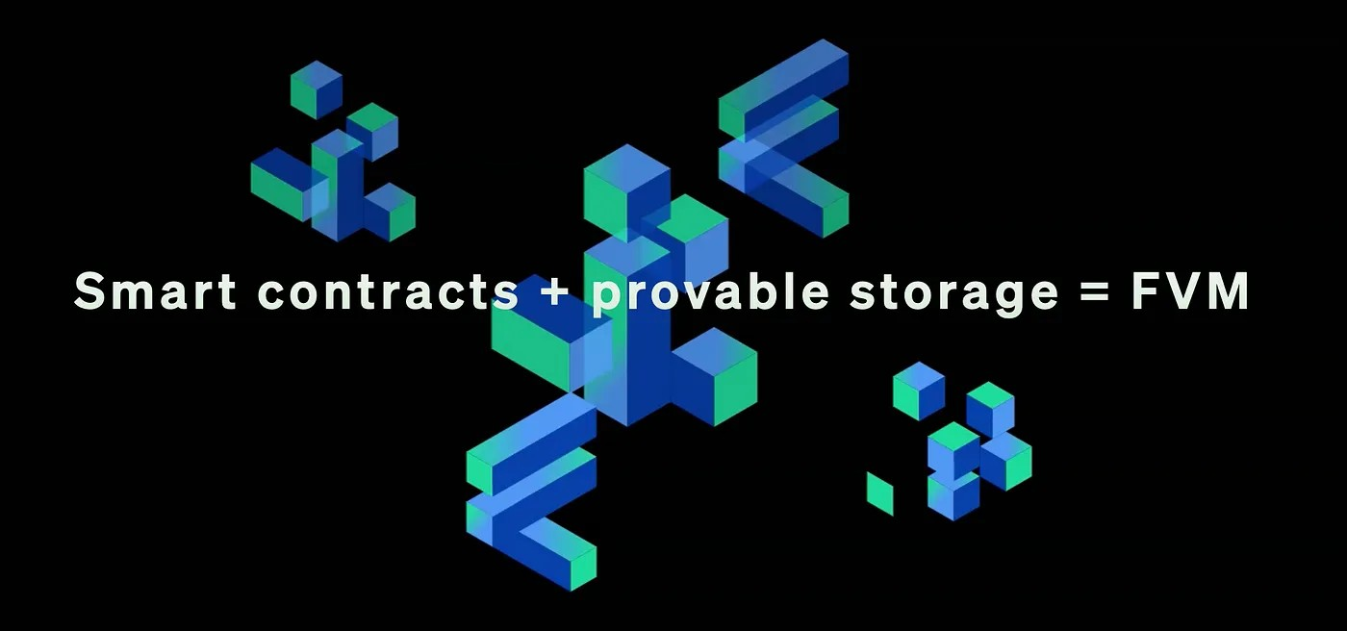
Request for Startups
DataDAOs
ML Model Storage and Augmentation
Games
Social
Decentralized Science
Perpetual Storage
Storage Automation
Decentralized Data Aggregator

Slide 11
Conclusion
FVM creates fertile ground for accelerated growth of the Filecoin ecosystem.

Slide 12

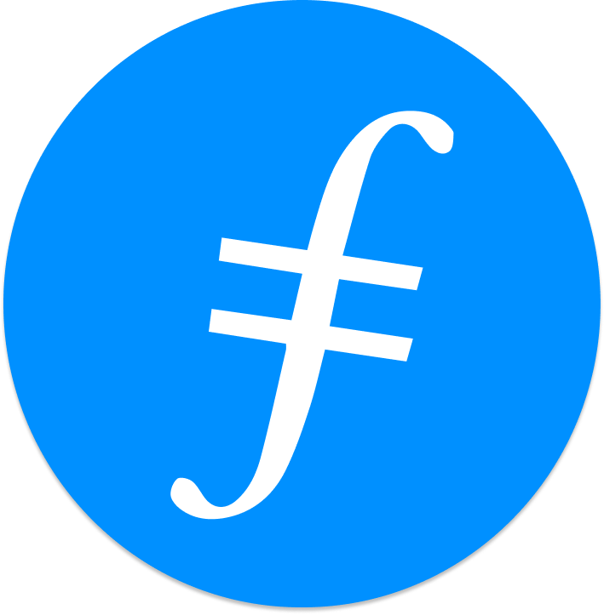
Feedback is welcomed.
https://github.com/kenlabs/Beginners-Guide-to-Filecoin

